Slide 1
Final Project
Przemysław Kazimierczak
ZDTESTpol125
[Guru99BankingSite]

Slide 2
Bank app Guru 99
The tested application is a simulation of a banking application.
Comprehensive documentation is available.
Achievements include:
Analysis of specifications
Risk assessment
Writing test cases using various tools, including Testrail
Execution of test cases
Generation of reports in Testrail
Defect reporting in JIRA
Automated testing using Selenium IDE
Development of a BDD scenario."

Slide 3
Bank app Guru 99
Generating a report in Testrail, reporting defects in JIRA, executing and recording an automated test in Selenium IDE, and writing test cases using the BDD methodology.
As the Guru99 application does not have a publicly accessible API, additional tests were conducted on one of the publicly available APIs. The exploratory session will utilize version V2 of the application.
Link to Guru99: https://demo.guru99.com/V1/
Link to API: https://restful-booker.herokuapp.com
Link to Guru99 V2: http://demo.guru99.com/V2/

Slide 4
Document Review

Slide 5
Project Risk
Changes in the scope of the project—alterations made by the client or stakeholders during the project's execution, especially in the case of such a complex application, are likely to result in potential delays, increased resource requirements, and consequently, higher costs.
Misunderstanding of requirements—incorrect or unclear understanding and specification of requirements can lead to the development of inappropriate or non-functional solutions from the perspective of stakeholders or clients.
Lack of resource availability—there is a risk of a shortage of access to adequately qualified programmers/testers, which may cause delays, cost escalation, and the risk of a decline in the quality of the produced software.

Slide 6
Product Risk
Security-related risk—banking applications contain sensitive data, and security breaches can result not only in the leakage of such data but also in the loss of funds and savings. Additionally, banking applications are frequent targets of hacking attacks.
Performance and scalability—banking applications must handle a large number of users and transactions simultaneously. In the event of performance issues, system failures may occur, resulting in customers losing access to their funds.
Risk of data loss—there is a vast amount of data associated with banking applications, including customer information and their deposits. Irreversible loss of this data could lead to a loss of access to accounts and funds

Slide 7
Przypadki testowe
Link to test cases Exel: Link

Slide 8
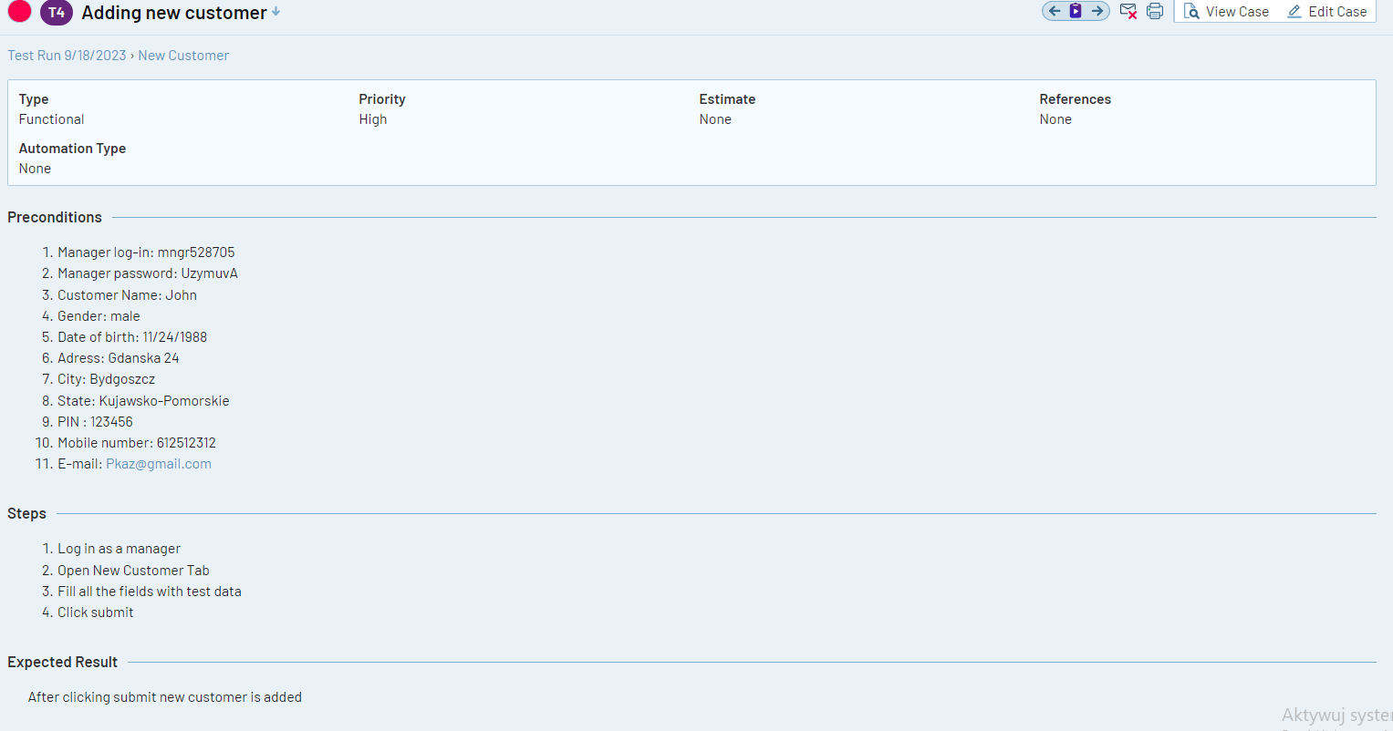
Adding new customer

Slide 9
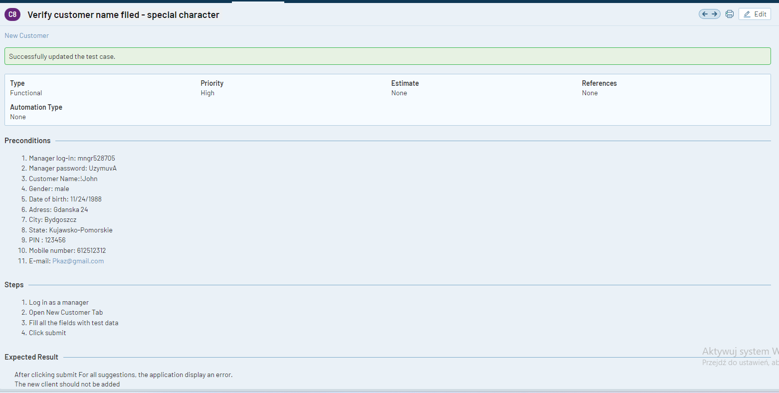
Verify customer name field- special character

Slide 10
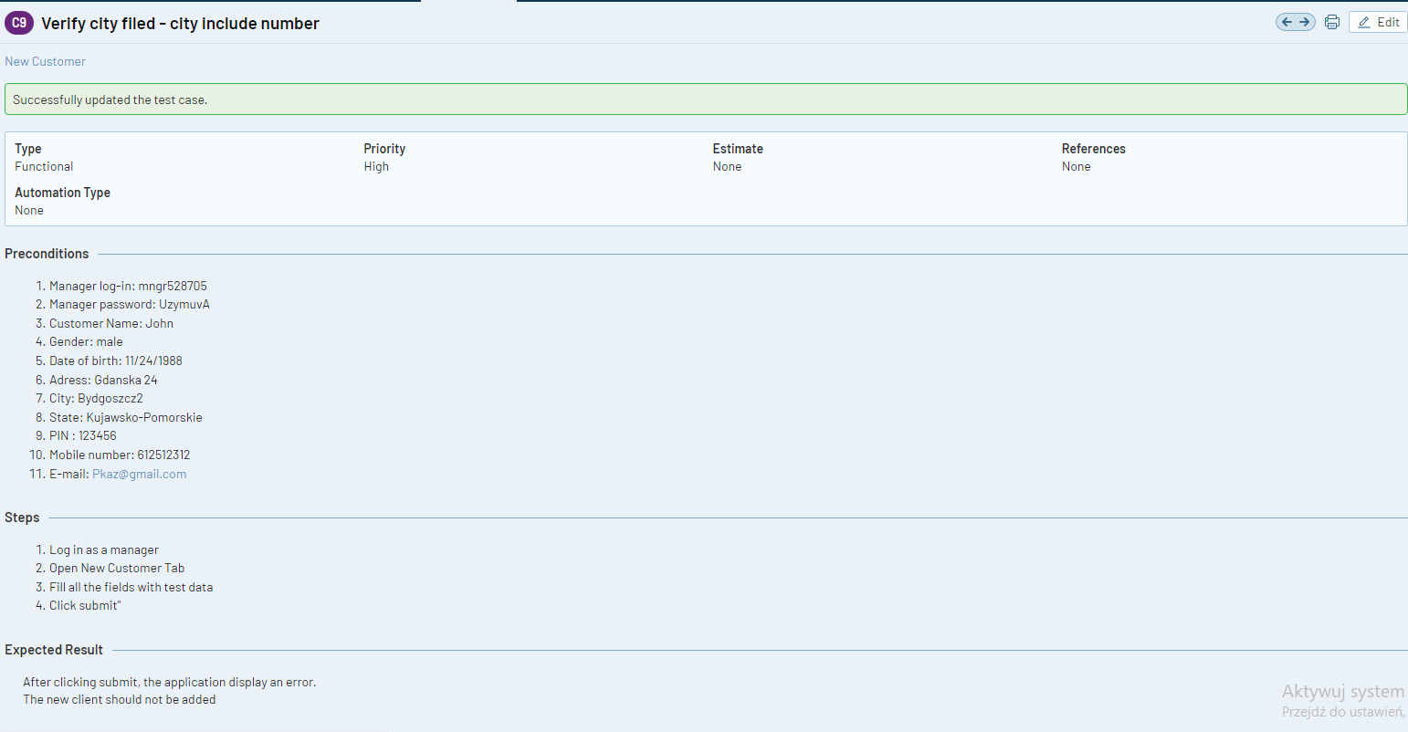
Verify city field - city include number

Slide 11
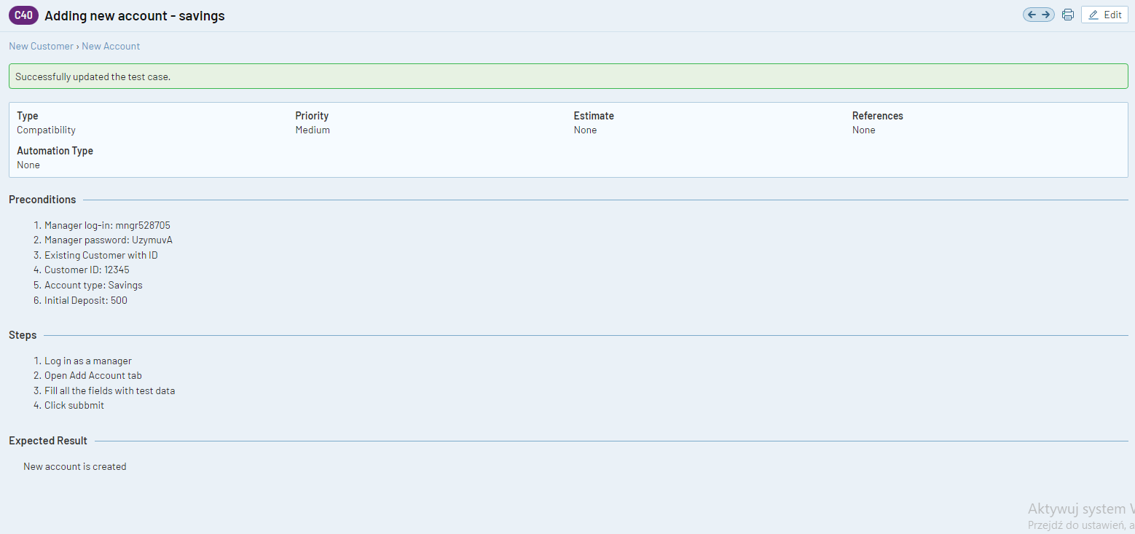
Adding new account - savings

Slide 12
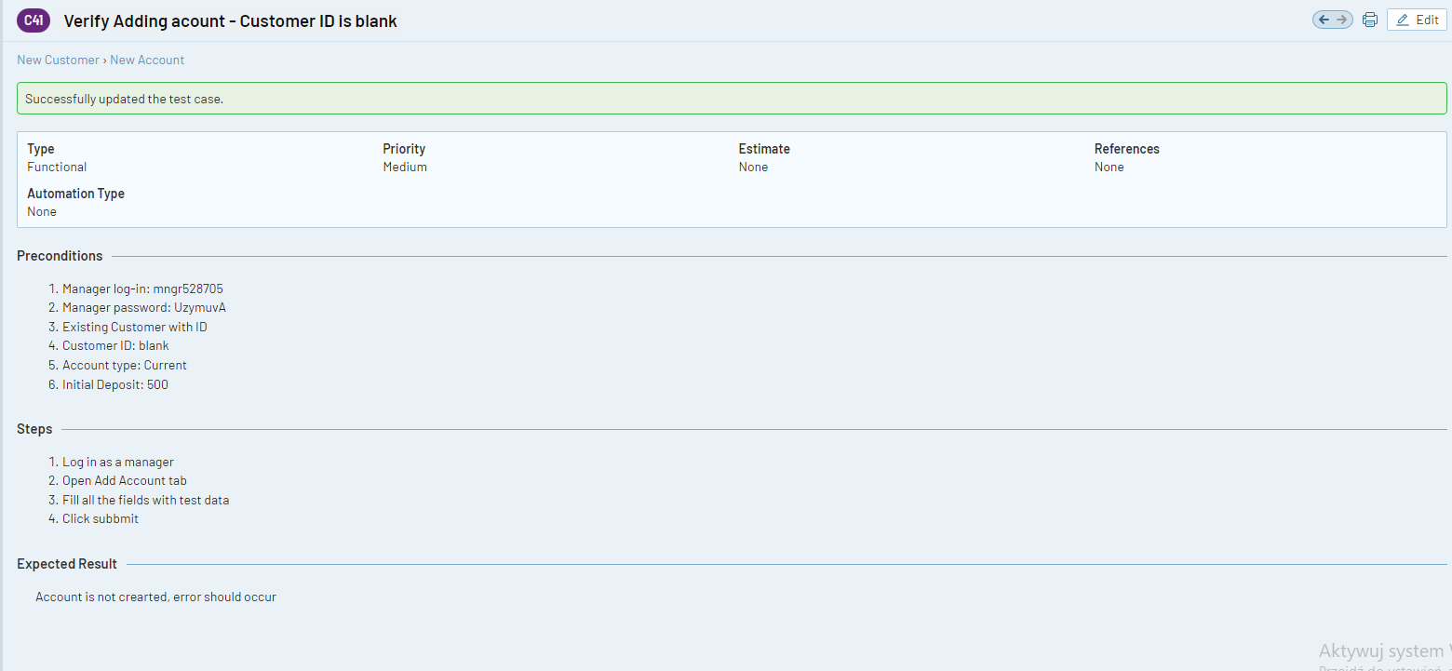
Verify adding account

Slide 13
Test case report - testrail
Link do raportu

Slide 14
Exploratory session
ID Sesji: ID1.21.09.2023
Tester | Przemysław Kazimierczak |  |  | Date | 20.09.2023 |  | App Version | V2
Start time | 21:00 |  |  | End Timenia | 21:30
Goal | Getting to know the new version of the application, Testing the functionality at the module integrity level (adding a client, searching for an added client, adding accounts), getting to know the new modules.
Bugs found | The application does not search for a previously added account, a previously added account cannot be deleted, the Balance Inquiry tab does not work, the mini statement module does not work, the customized statement module does not work. An error appears that such an account number does not exist.
Further analysis | Należy dokonać weryfikacji za pomocą API lub SQL czy bo utworzeniu nowego konta dla danego klienta, faktycznie postaje nowy record w bazie danych. Dwa z niedziałających modułów wyświetlają błąd z informacją że takie konto nie istnieje.

Slide 15
Record of Selenium IDE test
Link

Slide 16
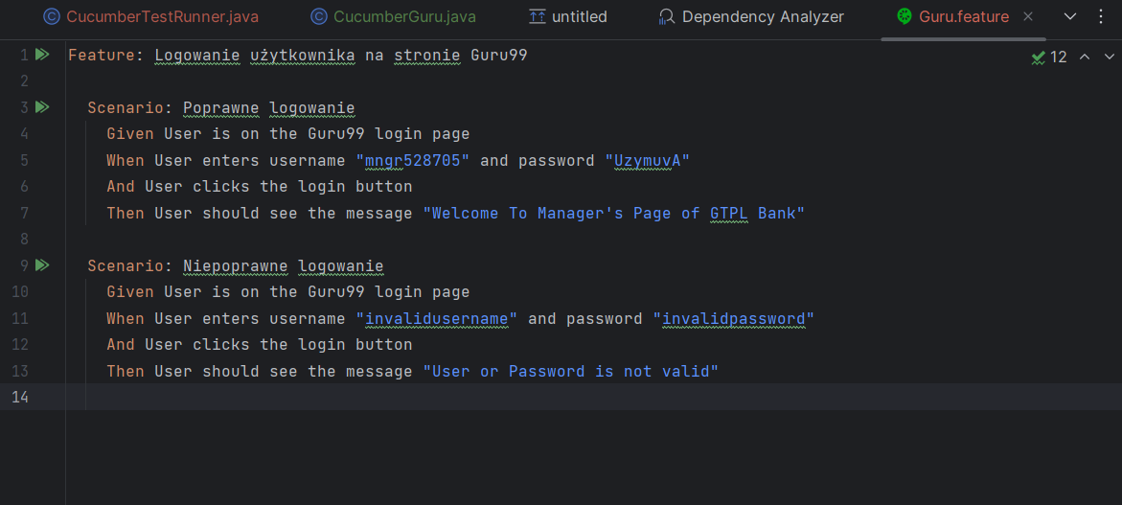
Test Case in BDD

Slide 17
Link to repozytorium

Slide 18
Testy API - Restful-booker API
Jest to ogólnodostępne API.
Do API jest dostępna dokumentacja.
Testy zostały wykonane na podstawie dokumentacji.

Slide 19
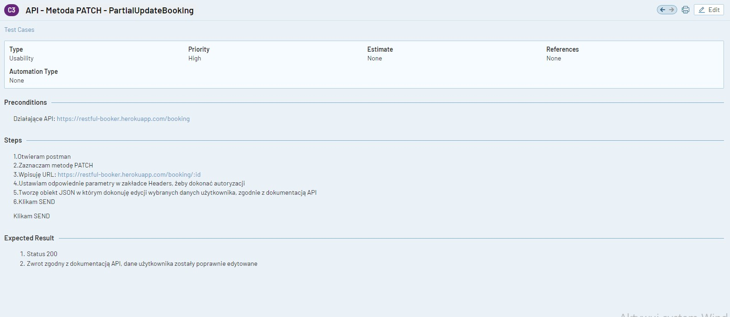
Testy API - Restful API - Przypadki testowe

Slide 20
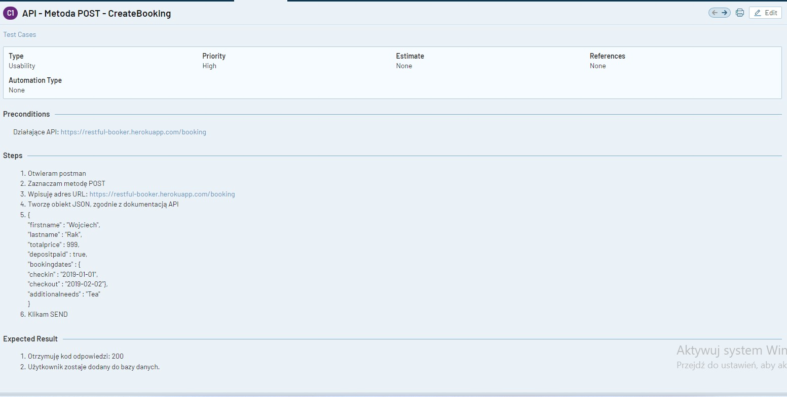
Testy API - Restful API - Przypadki testowe

Slide 21
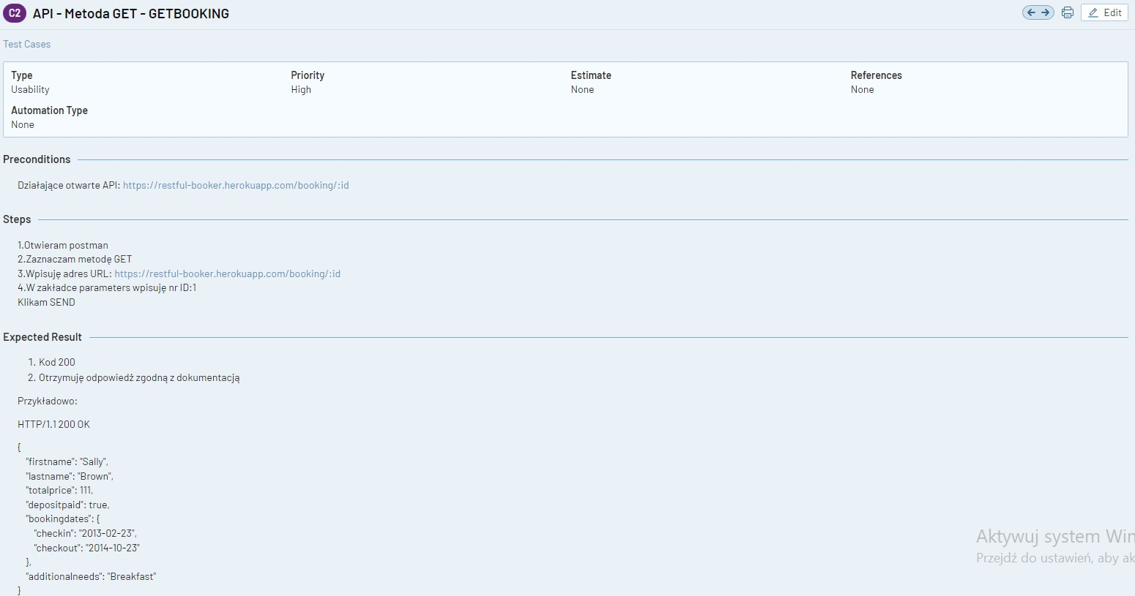
Testy API - Restful API - Przypadki testowe

Slide 22
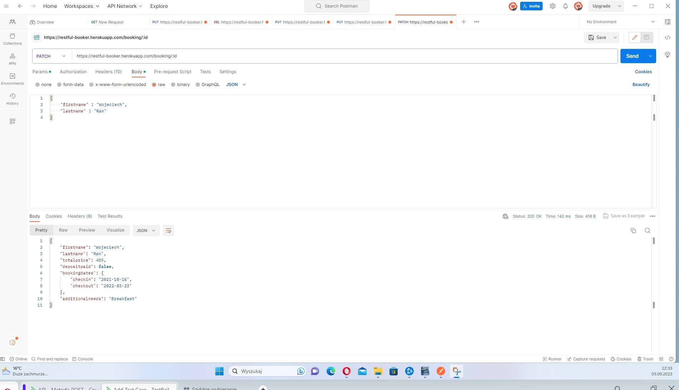
Test API - Restful API

Slide 23
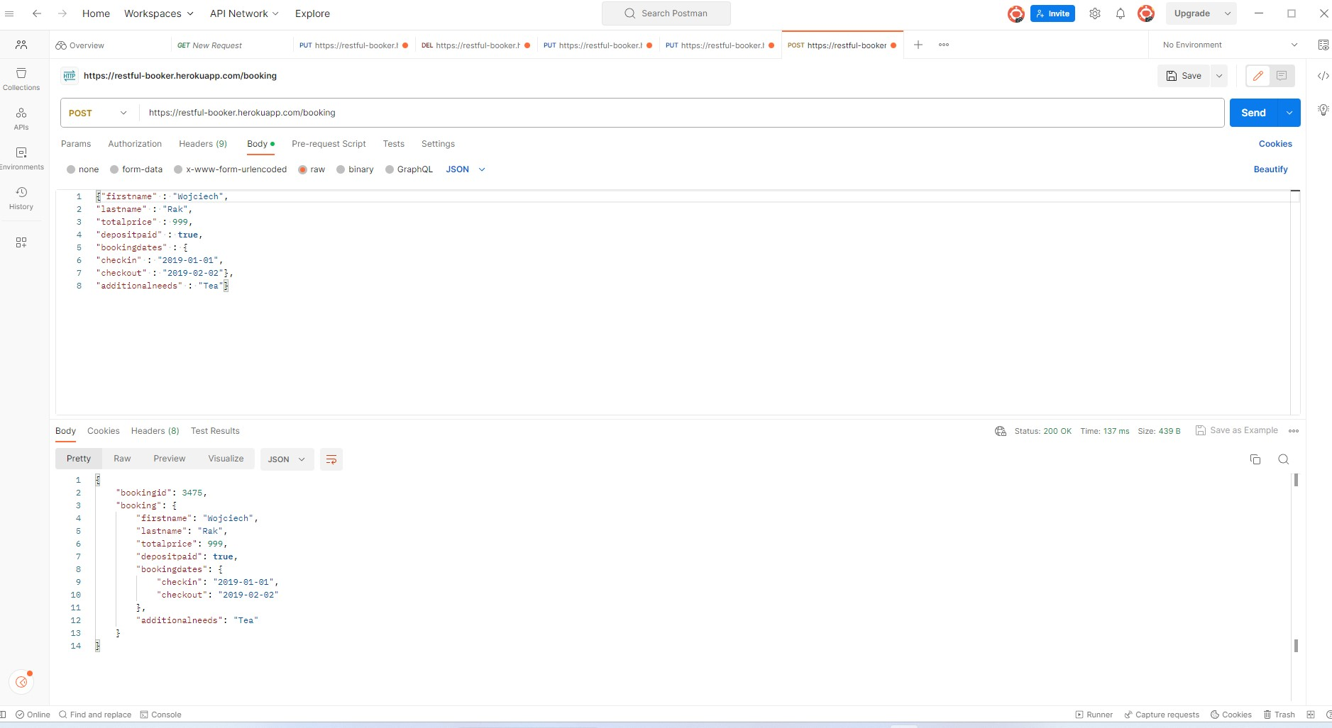
Test API - Restful API

Slide 24
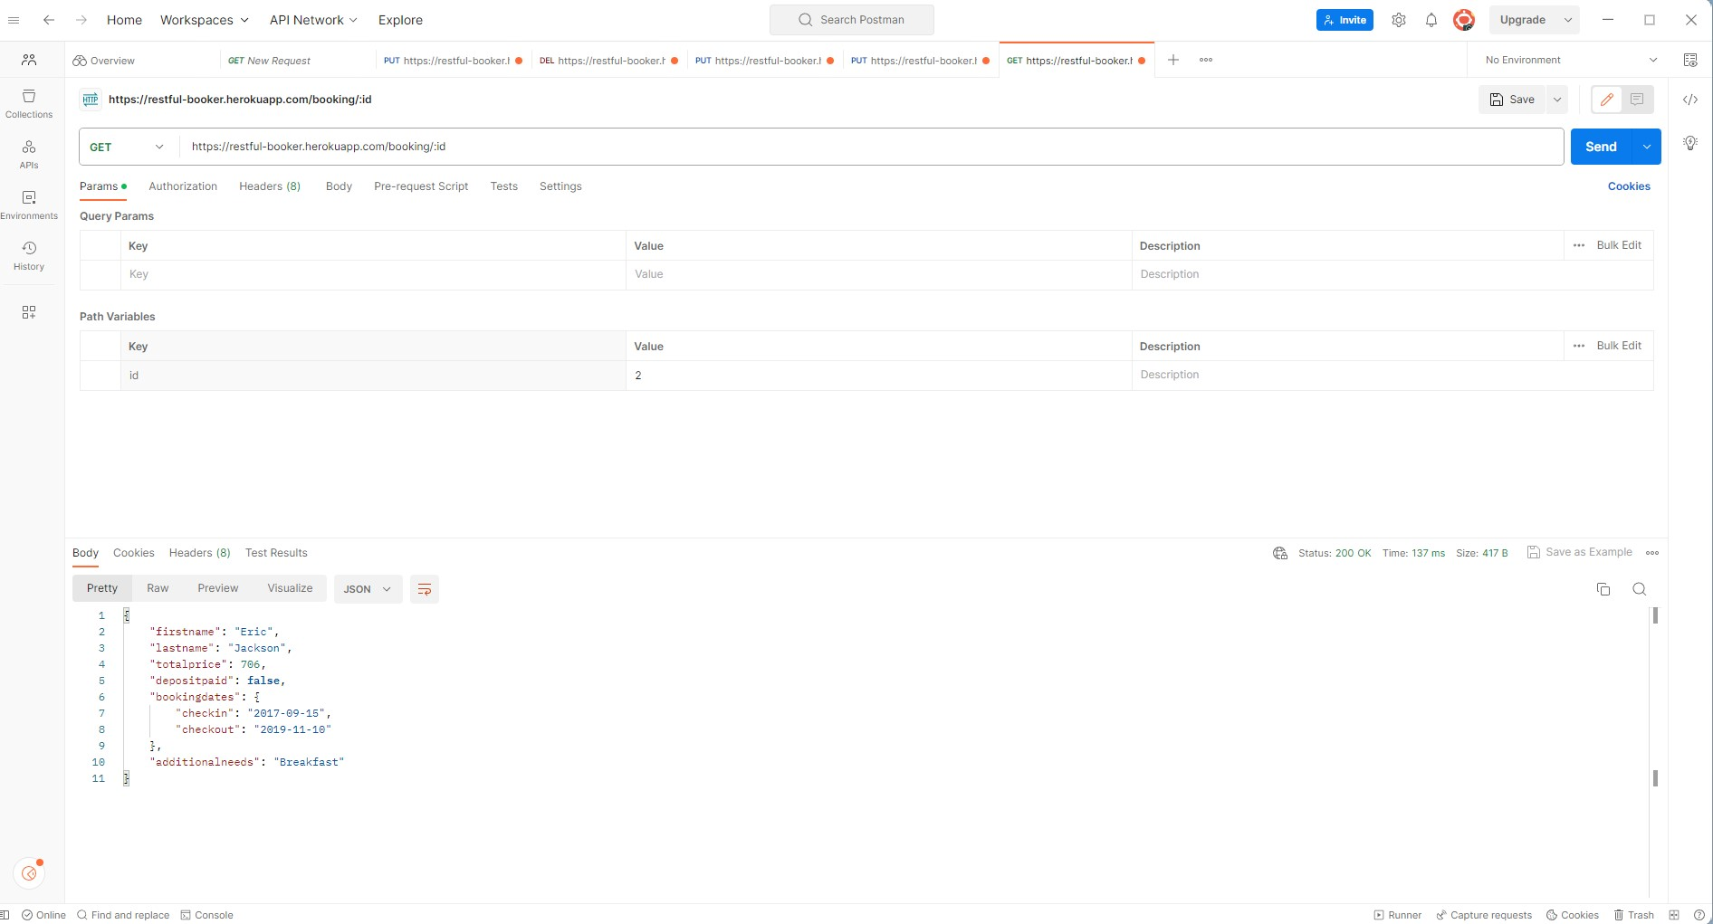
Test API - Restful API

Slide 25
API Test Report
Testrail Report

Slide 26
Example of using DevTools
I used Dev Tools to check Responsiveness on mobile devices link

